Slide 1
If n is an integer such that 1nn352 is a six-digit number exactly divisible by 24, what will be the sum of the possible values of n?
TCS NQT 2020

Slide 2
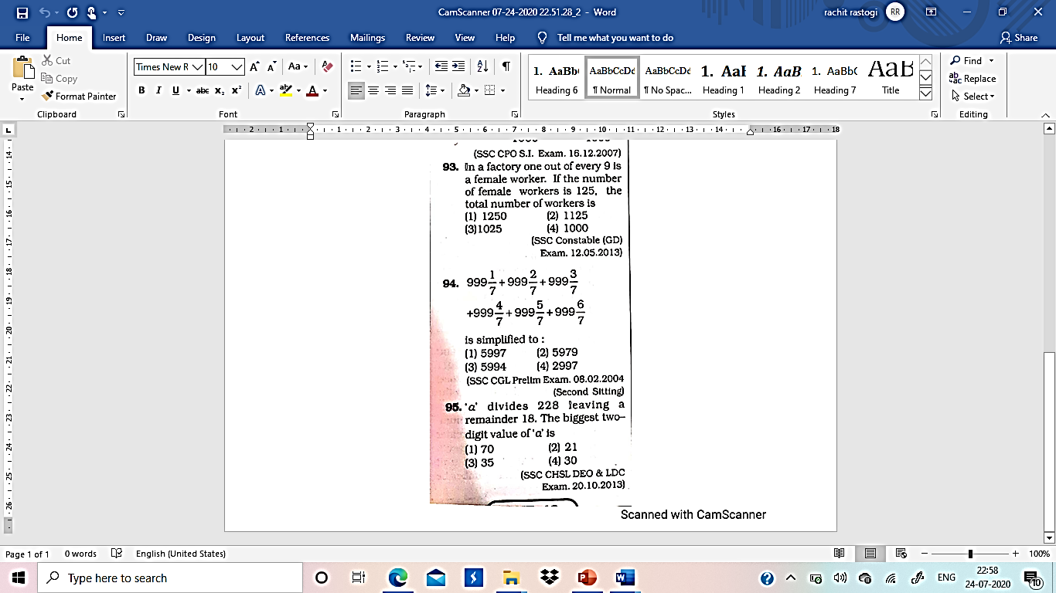

Slide 3
Find the Maximum number of trees which can be planted, 20 metres apat, on the two skies of a straight road 1760 metres long
180
178
174
176
(SSC CGL Tier-1 Exam 21.04.2013

Slide 4
If 5432*7 is divisible by 9 , then the digit is place of * is ?
(a) 0 (b) 1
(c)6 (d) 9
(SSC CGL Tier-I (CBE) Exam. 11.09.2016 (IIrd Sitting)

Slide 5
What least digit should come in place of # in the 9-digit number 15549#325, for which the number is divisible by 3?
1. 0 2. 1
3. 2 4. Any of these

Slide 6
If 5432*7 is divisible by 9, then the digit is place of * is?
(a) 0 (b) 1
(c)6 (d) 9

Slide 7
If 432 P1 is completely divisible by 9, then what is the value of P?
(a) 1 (b) 8
(c) 7 (d) 2

Slide 8
A hundred digit number is formed by writing first 54 natural numbers one after the other as 123456………5354.Find the remainder when this number is divided by 8 ?
(a) 4 (b) 2
(c) 7 (d) 0

Slide 9
If the number 91876X2 is completely divisibly by 8, then the smallest whole number in place of X will be: (a) 1 (b) 2 (c) 3 (d) 4

Slide 10
.For what value of M, 34M is divisible by 12?
(a) 2 (b) 0
(c) 8 (d) 6

Slide 11
Which of the given values Is divisible by 15?
(a) 2365 (b) 1375
(c) 4365 (d) 2275

Slide 12
When 335 is added to 5A7 result is 8B2. 8B2 is divisible by What is the Largest possible value of A ?
(a) 8 (b) 2
(c) 1 (d) 4

Slide 13
In a two digit number if it is known that its units digit exceeds its tens digit by 2 and that the product of the given number and the sum of its digits is equal to 144, then the number is
(a) 46 (b) 42
(c) 26 (d) 24

Slide 14
The product of two consecutive number is 9408 which of the following is the greatest number?
A)96 B)94 c)98 d)90 e)NOT

Slide 15
Average of 4 consecutive even number (P Q R S , In increasing order )is 51. What is the product of P and S ?
A)2592 b)2594 c)5293 d)2596

Slide 16
Average of 37 Consecutive number is 54. The largest of these number is ?
A)72 b)70 c)74 d)76

Slide 17
Average of 41 Consecutive odd Number is 49 . Which of the following is the largest number ?
A87 b)85 c)83 d)89

Slide 18
Average of 38 consecutive even number is 167. Find the sum of the smallest and largest number is?
A)167 b)334 c)332 d)336

Slide 19
Average of 29 Consecutive even number is 446. Find the difference between first and last number?
A.56 B.58 C.60 D.54

Slide 20
A number when divided successively by 5, and 2 gives respective remainders of 3 and 1. What will be the remainder when largest such two-digit number is divided by 12?

Slide 21
A number when divided successively by 5, and 7 gives respective remainders of 2 and 4. What will be the remainder when same number is divided by 35?

Slide 22
A number when divided successively by 12, and 15 gives respective remainders of 4 and 6. What will be the remainder when same number is divided by 180?

Slide 23
A number when divided successively by 8 and 9 gives respective remainders of 5 and 7. What will be the remainder when same number is divided by 72?

Slide 24
A number is divided by 1001 (=7*11*13) and it was divided in succession by 7,11 and 13, to obtain the remainders 4,6 and 12 respectively. What would have been the remainder if the number was divided directly by 1001?
A. 828 B. 982 C. 764 D. 970
TCS NQT 2020

Slide 25
Q. Find the number of divisors of 50?

Slide 26
Q. Find the number of different divisors of 307692?

Slide 27
If 8 men can reap 40 hectares in 12 days, then how many hectares can 30 men reap in 20 days?
If 30 men can build a wall 56 meters long in 5 days, what length of a similar wall can be built by 40 men in 3 days?

Slide 28
A job has to finished in 60days .40 men start the work ,each working 8 hrs a day, after 20 days just 1/4th of the work is finished .How many additional men need to be engaged to complete the work on time ,if all of them have now been asked to work for 10hrs a day ?
A.48 MEN B.8 MEN C.10 DAYS D.NOT

Slide 29
A job has to finished in 80 days .20 men start the work ,each working 6 hrs a day , after 60 days just 1/2th of the work is finished .how many additional men need to be engaged to complete the work on time ,if all of them have now been asked to work for 4 hrs a day ?
a.90men b.7 men c.70 Men d.Not

Slide 30
Q. Men or 4women or 6boys can complete the work in 25 days. In how many days 2men , 3 women , 4 boys can do in how many days?
Q. 2Men or 3Women can complete a work in 23days. Then in how many days 5men and 4women together can finish the work ?

Slide 31
If 2 men or 3 women or 4 boys can do a piece of work in 52 days, then the same piece of work will be done by 1 man, 1 woman and 1 boy in :
a) 48 days b) 36 days c) 45 days d) Data inadequate e) None of these

Slide 32
2 Men & 3women completed a task in 12days.if the women are at least half as efficient as the men, but not more efficient than the men, what is the range of the number of days for 3women & 1 man to complete the same task?
A.16 to 17.5 b.16.8 to 17.5 c.15 to 17.5 d.15 to 16.8 days

Slide 33
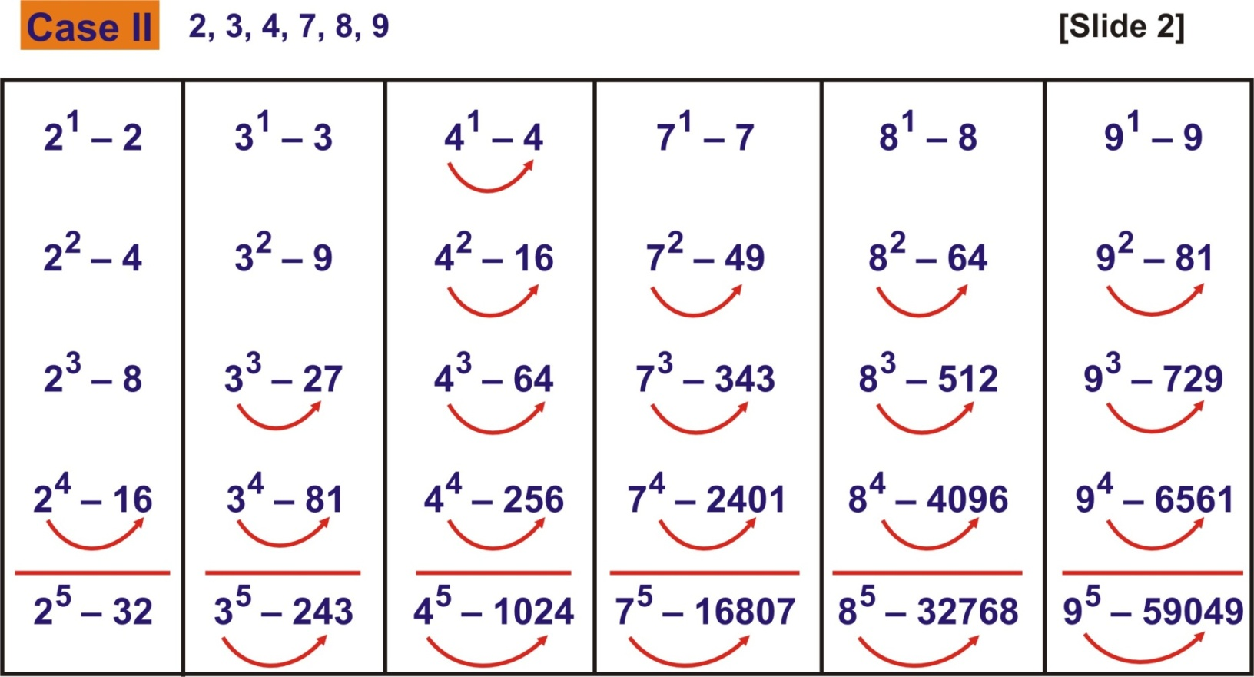
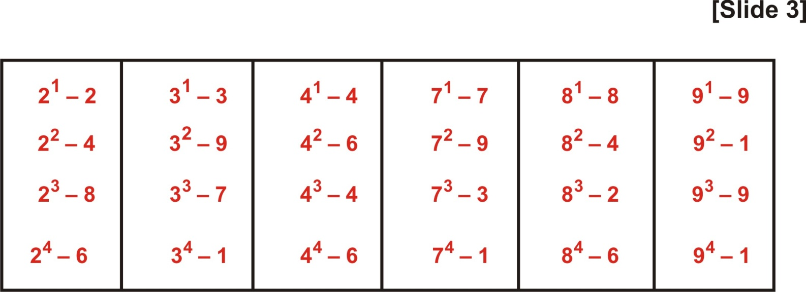

Slide 34
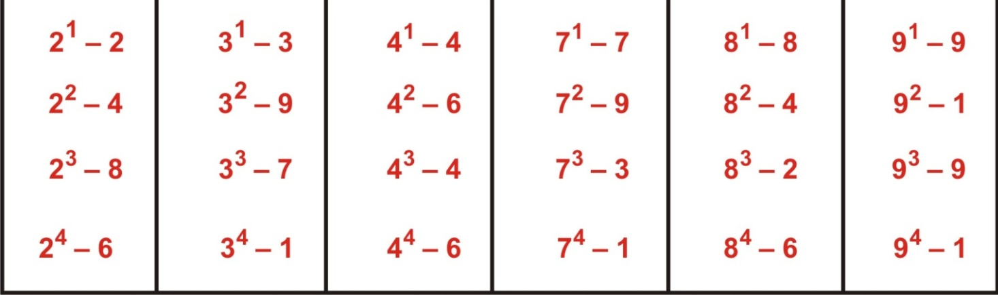
. The digit In unit's place of the product (2153)¹⁶⁷ is :
(a) 1 (b) 3
(c) 7 (d) 9

Slide 35
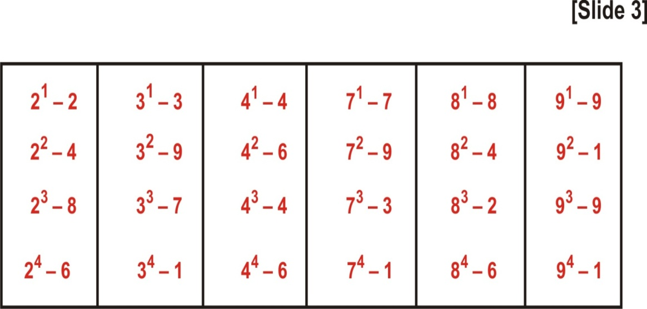
The unit digit in the expansion of (2137)⁷⁶⁴ is
(a) 1 (b) 3
(c) 7 (d) 9

Slide 36
What will be the unit digit in the product 7¹⁰⁵?
(a) 5 (b) 7
(c) 9 (d) 1

